Slide 1
MACHINE LEARNING PROJECT PRESENTATION
PRESENTED BY: EMAN TAHIR
REG# 2023-BS-AI-015
SUPERVISED BY: MR. M.SAEED

Slide 2
PROJECT INTRODUCTION
PROJECT 2:
OBESITY CLASSIFICATION

Slide 3
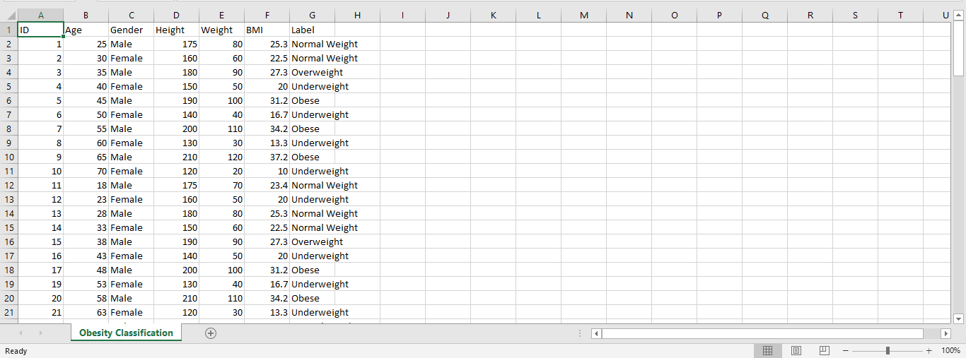
DATASET
SOURCE: Kaggle
DESCRIPTION: The "Obesity Classification" dataset contains 2111 records with 17 attributes related to personal, dietary, and physical activity habits, aiming to classify individuals as obese or not using health indicators.

Slide 4
PRE-PROCESSING STEPS
"Preprocessing steps refer to the essential data cleaning and transformation tasks performed before feeding data into a machine learning or statistical model. These steps improve data quality, ensure consistency, and make the dataset suitable for analysis or modelling."
Load Dataset: Import CSV file into a pandas DataFrame.
Explore Data: Check structure, missing values, and general insights.
Encode Categorical Variables: Convert non-numeric data using Label Encoding.
Split Dataset: Divide data into training and testing sets.
Train Model: Apply RandomForestClassifier for obesity classification predictions.
Evaluate Model: Measure accuracy using classification report and score.

Slide 5

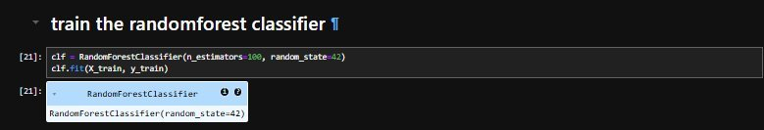
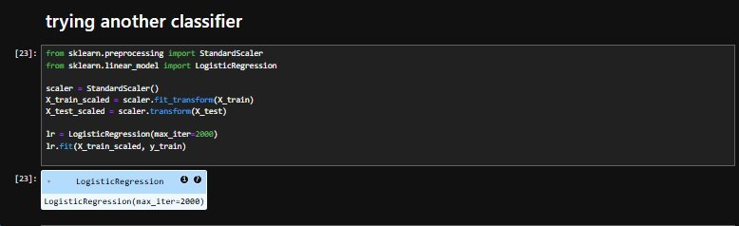
MODELING
Train-Test Split
Split data into training and testing sets for model validation.
Model Training
Fit model on training data to learn decision-making patterns.
Model Selection
Choosing Random Forest suitable for multiclass classification problem tasks.
Model Initialization
Create Random Forest classifier object using default or tuned parameters.

Slide 6
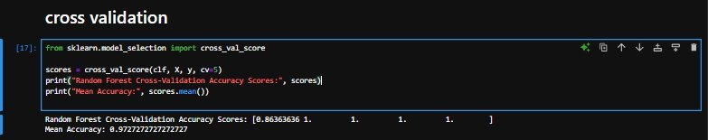
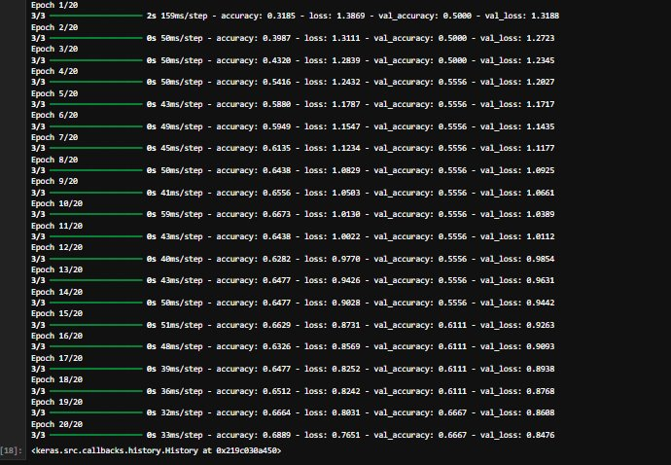
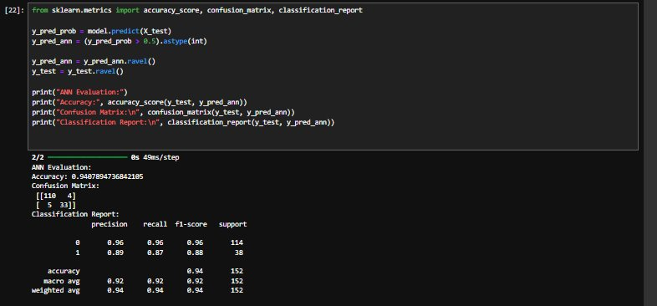
MODELING
ANN
Data preprocessing, model creation, training, validation, evaluation, performance analysis, optimization, predictions, accuracy measurement, confusion matrix visualization.

Slide 7
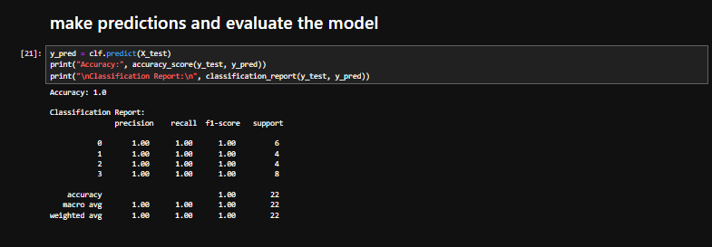
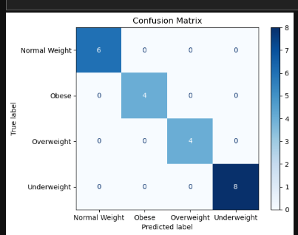
EVALUATION
Accuracy Score
Measures how many predictions are correct out of total predictions.
Classification Report
Provides precision, recall, F1-score for each predicted class label.
Confusion Matrix
The confusion matrix visualizes classification model performance using predicted values.

Slide 8
KEY FINDINGS
Random Forest model achieved strong classification performance and accuracy.
Label encoding was successfully applied to handle categorical data.
The model generalized well to unseen test data.
Evaluation showed balanced precision, recall, and F1-scores.
Workflow was clean with proper training and prediction steps.

Slide 9
CONCLUSION
The Random Forest Classifier successfully predicted obesity categories with high accuracy, demonstrating the effectiveness of machine learning in health risk prediction. Proper encoding and model evaluation ensured reliable results, indicating the model's potential for real-world applications in health monitoring systems.

Slide 10
THANKYOU!

